Slide 1



MAF: Exploring Mobile Acoustic Field for Hand-to-Face Gesture Interactions
ACM CHI 2024
Yongjie Yang, Tao Chen, Yujing Huang, Xiuzhen Guo, and Longfei Shangguan
Notes:
Thanks for Prof. Yan’s introduction. Hello everyone, I am Yongjie, and I am from the University of Pittsburgh. Today I am going to share our recent work, which is called MAF: exploring mobile acoustic field for hand-to-face gesture interactions

Slide 2


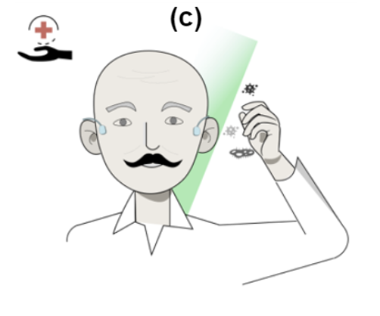
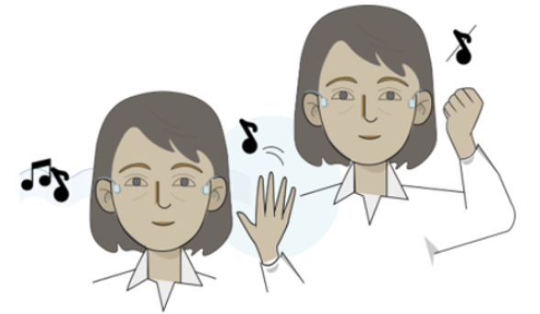
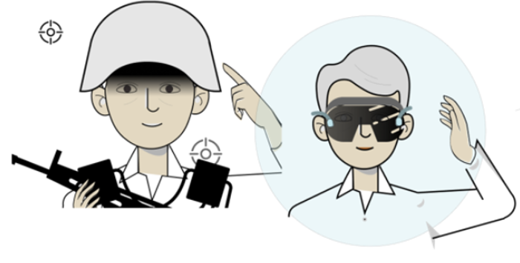

Hand-to-Face Gesture Interaction is Gaining Popularity
Intuitive and Efficient Interaction
Convenience
Adaptability
Versatility
Software-defined Control
Enhanced VR/AR Gaming Experience
Virus Spread Prevention
Notes:
Hand-to-face gestures play an important role in how we communicate and control devices in our daily lives. Let’s look at their key attributes:
First, they’re natural and easy to use. You can quickly perform tasks and learn gestures without much effort.
They offer incredible convenience too. You can interact with technology freely, no matter where you are, without needing special equipment.
These gestures are also adaptable. They can be customized to fit each user’s preferences and actions.
And they’re also versatile.
For example, with a simple gesture, you can skip a song on your playlist.
They enhance virtual environments as well, like VR and AR, by making the experience more interactive.
They also help keep us clean by cutting down on how often we touch our faces, which is great for public health.
Overall, hand-to-face gestures make interacting with our technology smoother and more intuitive.

Slide 3

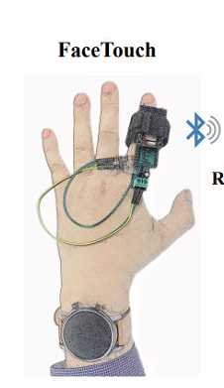
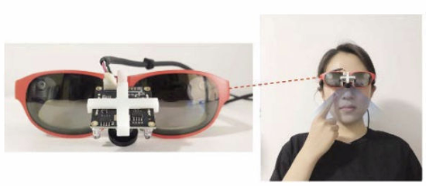
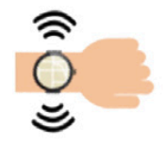
Overview of Existing Solutions
FaceSight
FaceGuard
FaceTouch
[Weng et al. CHI ‘21]
[Michelin et al. Frontiers‘21]
[Liu et al. IoTDI‘23]
Vision-based Solution
IMU-and Vibration- Solutions
High computational demand.
Poor performance in low light.
Occlusion issues.
Privacy concerns.
Low sampling rates.
Low accuracy and precision in tracking complex gestures.
Notes:
Let's talk about how we recognize hand-to-face gestures nowadays.
For example, Facesight placed a camera onto your glasses to notice when your hand is near your face.
[x]But these vision-based methods can be heavy on processing power and cost, not to mention they often struggle with poor lighting or if something's in the way. And there's always that worry about privacy for users.
Then there are techs like faceguard or facetouch, which rely on IMU or vibration sensors to feel when your hand touches your face.
[x]They're a bit simpler but come with their own trade-offs, like not being as quick to respond or missing the mark on more complicated gestures.

Slide 4
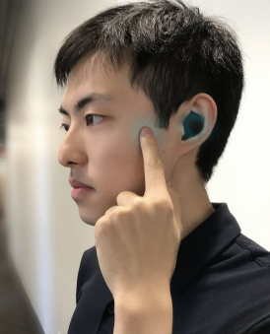
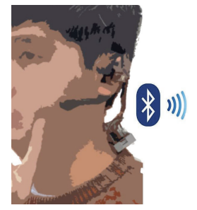
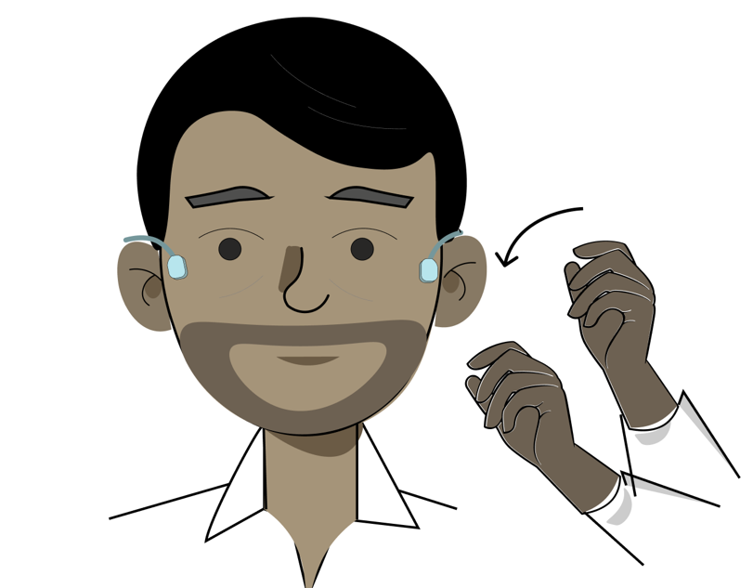

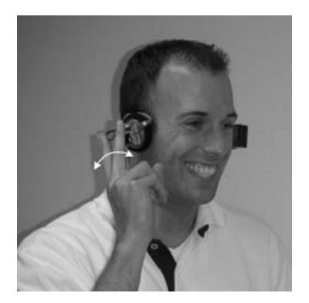
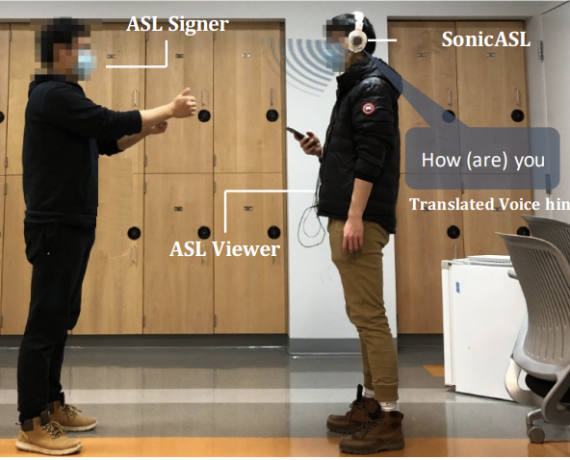
EarBuddy
FaceSense
Earable-based Solutions
Limited Interaction Modalities
[Xu et al. CHI ‘20]
[Kakaraparthi et al. IMWUT ‘21]
FreeDigiter
SonicASL
Requirement of Additional Dedicated Sensors
[Metzger et al. ISWC ‘04]
[Jin and Gao et al. IMWUT ‘21]
4
Notes:
Recently, the emerging earable-based solutions has shown great efforts for hand-to-face gestures.
For example, earbuddy uses microphones in noise-canceling earphones to pick up the sound of gestures near the face and ears. And 'facesense' brings a new twist with thermal-sensing earbuds for recognizing gestures.
[x] Although these earable technologies are quite inventive, they're not without their challenges — for example, they're not that great at picking up gestures that happen above the face.
On the other hand, ‘FreeDigiter’ gets creative by incorporating proximity sensors into earbuds for finger gestures close to the ear, without any contact. And ‘SonicASL’ uses a unique setup with a speaker and microphone to interpret sign language for those who are deaf.
[x]These approaches broaden how we can interact but also bring the challenge of integrating more complex hardware of dedicted sensors.

Slide 5

Can we design a system that is able to detect hand-to-face gestures, whether in contact with the face or above it, using widely accessible commodity earphones?
Notes:
So based on previous works’ contributions and limitations we have a question, Can we design a system that is able to detect hand-to-face gestures, whether in contact with the face or above it, using widely accessible commodity earphones?

Slide 6
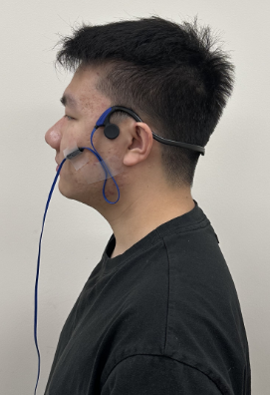




Notes:
We observed something fascinating.
[x]When we put a speaker near our face and play music, there's a distinct reaction.
[x]The sound causes a subtle vibration in the skin's surface tissue.
[x]And, a portion of the signal's energy slightly leaks into the surrounding air

Slide 7
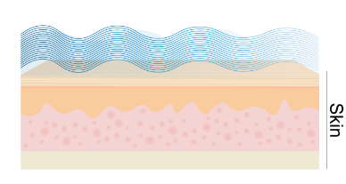
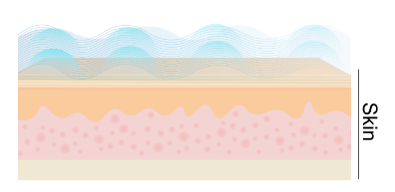
SAW
1. Surface Acoustic Wave (SAW) is an acoustic wave that travels along the surface of an elastic material.
2. Leaky Surface Acoustic Wave (LSAW) is an acoustic wave that travels on an elastic surface but also partially transfers energy into the adjacent medium.
LSAW
Notes:
This phenomenon is explained by two types of signal behaviors. One is the surface acoustic wave that travels along the surface of an elastic material.
, and the another one is the leaky surface acoustic wave which is an acoustic wave partially transfers energy into the adjacent medium.

Slide 8
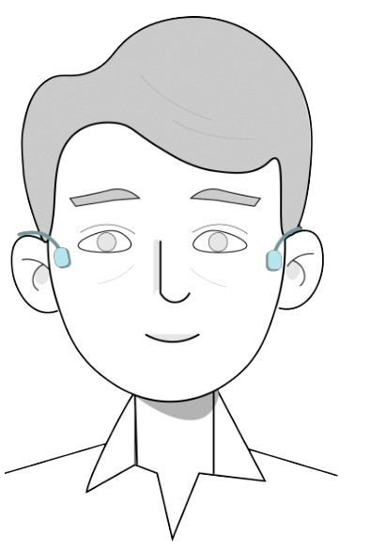



SAW
LSAW
Mobile Acoustic Field (MAF)
Notes:
[x]Building on this observation, we see that these signals create an acoustic field around the user's head. The headset, being both convenient and portable, allows this acoustic field to move with the user. That's the reason we've named this phenomenon the 'mobile acoustic field,' or MAF.

Slide 9
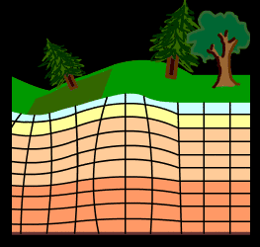

Semiology
Leaky Surface Wave
Rayleigh Wave
L., D. (2015, September 27).
Notes:
To better understand the principle behind these waves, let's look at a common example from nature in semiology: earthquakes. Earthquakes create surface waves that travel along the Earth surface. These are known as Rayleigh wave.
But there's more. Some of the energy from Rayleigh waves also spreads into nearby areas. This spreading is what we call a leaky surface wave.

Slide 10
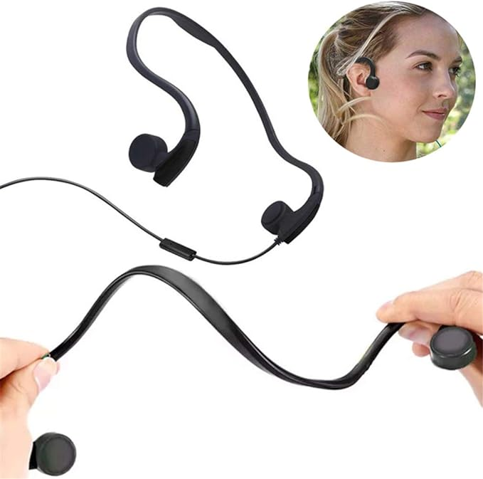
Bone Conduction Earphone
GZCRDZ. (n.d.). Amazon.com: GZCRDZ Bone Conduction Wired headphones with noise ... https://www.amazon.com/Easycat-Conduction-Headphones-Microphone-Headphone/dp/B07CB7VWT8
Notes:
Inspired from these natural phenomena, we‘ve identified a novel application. By using the concept of surface and leaky acoustic waves, we’ve found a unique opportunity with bone-conduction earphones to build a mobile acoustic field.

Slide 11
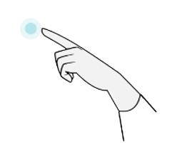
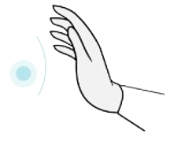
Touching Face
Notes:
With this acoustic field established by bone-conduction earphones, let's pivot back to hand-to-face gestures.
Our research has shown that different gestures within this field cause notable changes. Essentially, gestures close to or near the face can alter the patterns of both surface and leaky acoustic wave signals.
Now, let's show the examples what happens when we touch our face.

Slide 12
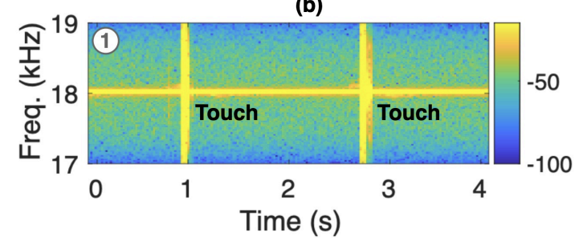
Approaching Face
Notes:
We've observed that in the frequency domain, this action introduces a distinct signal alteration. What if we perform the approaching gestures,

Slide 13
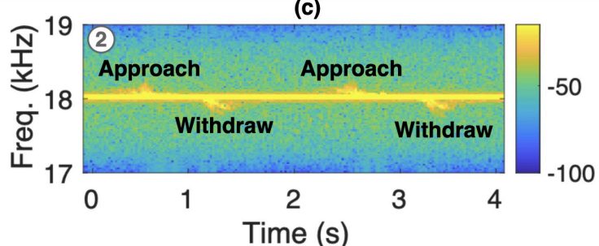
Notes:
The results are promising, the user gestures performed on or in the vicinity of the face can perturb the channel of surface and leaky acoustic wave signals which caused the clear patterns.

Slide 14



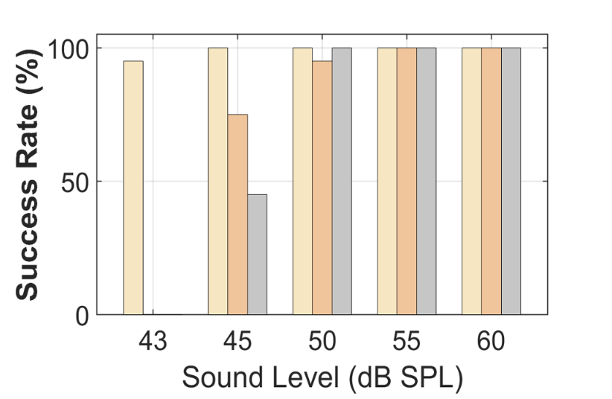
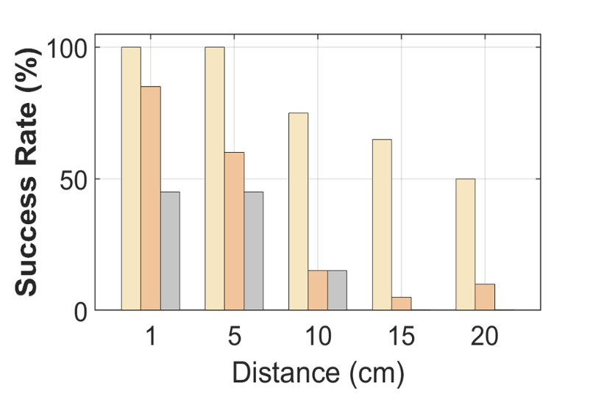
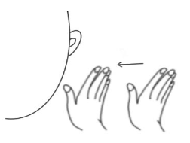
Study 1: Understanding MAF
Left-facial Region
Middle-facial Region
Right-facial Region
Approach
A participant executed twenty times approaching gestures.
The MAF showed optimal detection at a transmitted signal intensity of 45dB SPL for the left facial region.
The MAF achieved optimal detection when the gesture was performed 5 cm away from the left side of the face.
Notes:
Let's explore how the MAF performs with various signal settings and distances for a better understanding. Our goal is to find the right balance – we need a strong signal for accurate detection, but not so intense that it bothers human ears.
[x]We had a participant perform approaching gestures towards her face - twenty times.
[x]The findings were clear. The MAF worked best when the transmitted signal was at 45dB SPL, particularly for gestures near the left side of the face, and at a distance of about 5cm. Which means we can use a safe sound level to detect the gestures.

Slide 15
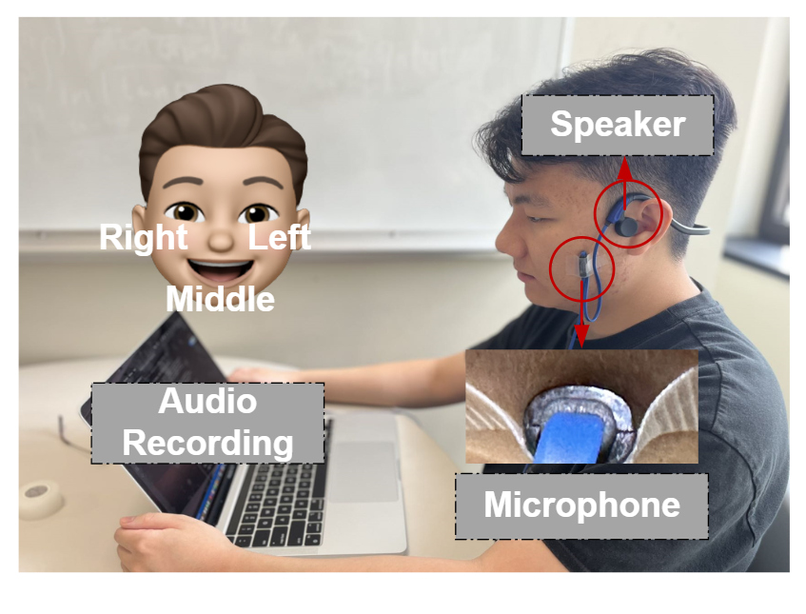
Study 2: Gesture Set Selection
N = 22 (Gender: 12 Male, 10 Female; Age: 16-55 years old )
A Likert scale survey to tailor the gestures:
Simplicity
Social acceptability
Fatigue
Ambiguity
Notes:
Next, we focused on defining the gestures. To do this, we brought in 22 participants to help us select a dozen of gestures. Each person wore commercial bone-conduction earphones and performed each gesture. After that, they filled out a survey using a Likert scale, and it is covered for four aspects:simplicity, social acceptability, 佛teeg, and ambiguity. This helped us determine which gestures were user-friendly.

Slide 16
Study 2: Gesture Set Selection
Based on the scores received from user feedback, we refined our original set of twelve gestures down to ten.
Notes:
Let me briefly talk about the survey results displayed in this graph, a higher score means better.
[x]Gesture ‘C’ pinching face and gesture ‘F’ scratching face received the lowest scores, because most users found them annoying.
[x]Based on this feedback, we refined our original twelve gestures down to a more user-friendly set of ten.

Slide 17
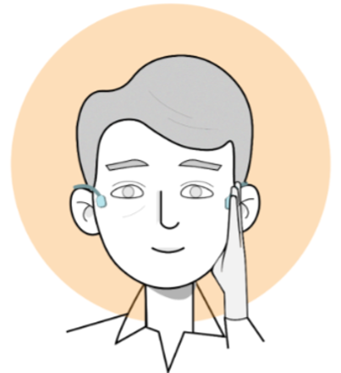
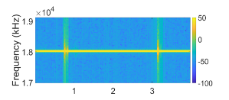
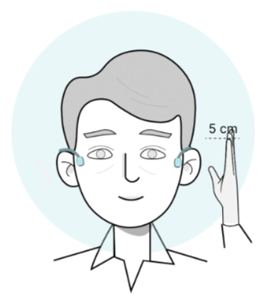
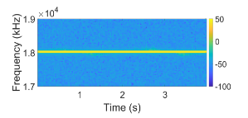
System Design
a. Signal Processing Pipeline
Raw Spectrogram
Single-tone ultrasound probing signal: 18kHz or above fixed frequency.
Notes:
After analyzing the survey results and refining our gesture set, we shift our focus to the system design for gesture detection and recognition. Our system consists of two key components. In the first step of signal pre-processing, we chose a single-tone inaudible probing signal at 18kHz as our transmission signal.

Slide 18
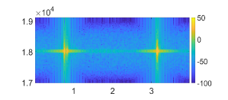
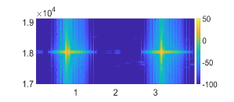
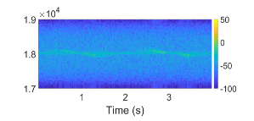
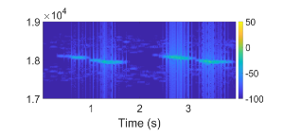
System Design
a. Signal Processing Pipeline
Raw Spectrogram
Bandpass and Bandstop filters
Wiener filter
Single-tone ultrasound probing signal: 18kHz or above fixed frequency.
Filters: filtering original probing signal and other environmental noise.
Notes:
Second, we adopt several filters to filter our gesture signals. To be specific, we used band pass and band stop filters to filter the original probing signal. And we applied an advanced wiener filter to avoid noise.

Slide 19
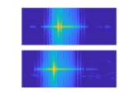
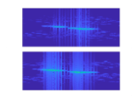
System Design
a. Signal Processing Pipeline
Raw Spectrogram
Bandpass and Bandstop filters
Wiener filter
Kullback-Leibler divergence-based segmentation
Single-tone ultrasound probing signal: 18kHz or above fixed frequency.
Filters: filtering original probing signal and other environmental noise.
KL divergence segmentation: 2.5s window length for longest gesture performed.
Notes:
The final step of the signal processing pipeline is using a KL divergence segmentation with a 2.5 second window to fully segment a gesture.

Slide 20
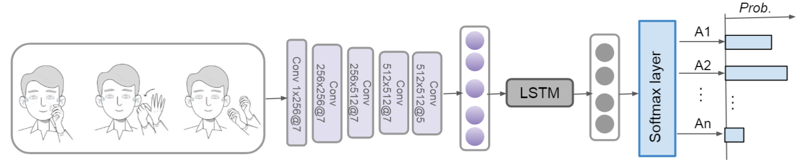
System Design
b. Classification Model
Input: Uses STFT spectrogram for detailed time-frequency data.
Architecture: Combines 5-layer CNN, a bi-directional LSTM, and a classic MLP.
Output: Softmax layer provides class probabilities.
Overfitting Prevention: Implements cross-validation, regularization, early stopping, and dropout.
Notes:
For the second step of our system design, we focused on gesture classification. We utilized a deep neural network model.
This model includes five layers of convolutional neural networks and a bi-directional long short-term memory layer to accurately recognize different gestures.
We chose a short-term Fourier transform spectrogram as our model input because it offers a rich blend of time and frequency information.
To ensure the model's reliability and avoid overfitting, we implemented several methods: leave-one-out cross-validation, L2 regularization, and combined early stopping with dropout layers.

Slide 21
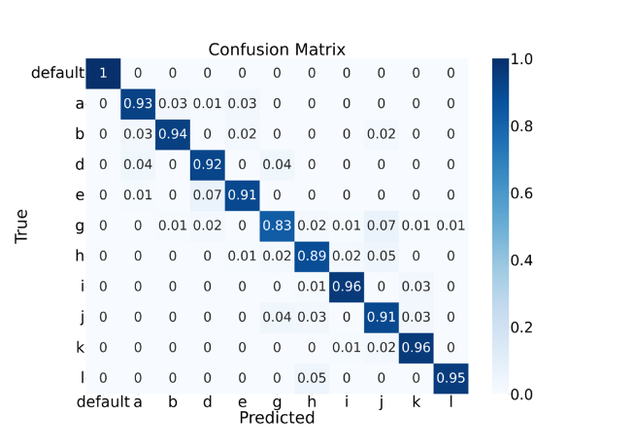
Study 3: System Evaluation
Recognition accuracy rate: 92% across ten gestures.
Notes:
In the final evalution, it achieved a 92% 爱Qracy rate in recognizing ten different gestures in the validation set.

Slide 22
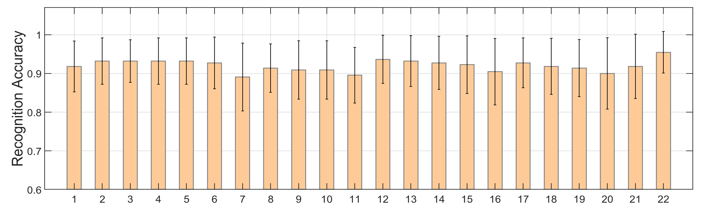
Study 3: System Evaluation
Leveraging a leave-one-out approach.
Recognition accuracy rate: 91% across all users.
For additional details on the benchmarks, please refer to the paper.
Notes:
So let us talk about the leave-one-out approach to test the system's performance across various users. The results were promising: the recognition 爱Qracy remained consistently high, around 90% for all users.
For more in-depth information about our benchmarks and methodologies, please refer to the detailed explanations in our paper.

Slide 23
Summary
Identified a new hand-to-face gesture interaction method with bone conduction earphones.
Demonstrated high accuracy in gesture recognition with a data-driven approach.
Evaluated user acceptance and attitudes with a comprehensive study involving 22 participants.
Notes:
In summary, we have Identified a new hand-to-face gesture interaction method. And the system can achieve a high 爱Qracy on the validation set.
The last thing we also Evaluated user acceptance and attitudes involving 22 participants.

Slide 24
Thanks for Listening!
Yongjie Yang
yoy28@pitt.edu

